Slide 1
ECE 3130 Digital Electronics and Design
Lab 2
Introduction to Tanner Tools and implementing logic gates
Fall 2016
Slides credit to : Boqun Dong

Slide 2
Objectives
Review of basic digital circuit concepts
Introduction to digital circuit design and simulation
Introduction to basics of the Tanner Tools software
Assignment
Design Inverter and NAND gate
Find out the propagation delay of Inverter and NAND gate

Slide 3
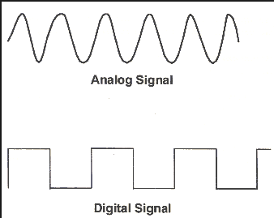
How do digital circuits work?
Analog – continuous signal
Digital – discrete signal
Fundamentally binary devices
Quantization of voltage
HIGH
LOW

Slide 4
Logic Gates
AND
OR
NOT(Inverter)
NAND
NOR
XOR
XNOR

Slide 5
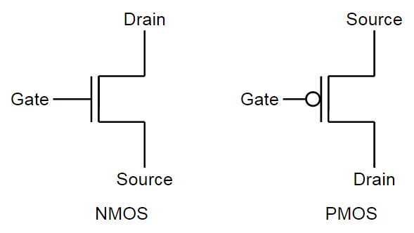
Introduction to MOSFETS
Two types
PMOS – source connected to V_{HIGH}
NMOS – source connected to V_{LOW}

Slide 6
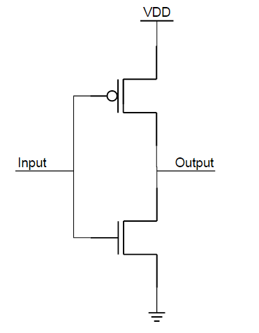
Inverter
Truth table
Implementation
Input | Output
0 | 1
1 | 0

Slide 7
Tanner Tools Components
5 Modules
L-Edit – Physical Design Tool
LVS - Layout versus Schematic
S-Edit – Schematic Capture Tool
T-Spice - the SPICE simulation engine integrated with S-edit
W-Edit – Waveform Probing

Slide 8

Let’s Start…
Start → All Programs → Tanner EDA → Tanner Tools v16.2 → S-Edit v16.2 64-bit

Slide 9
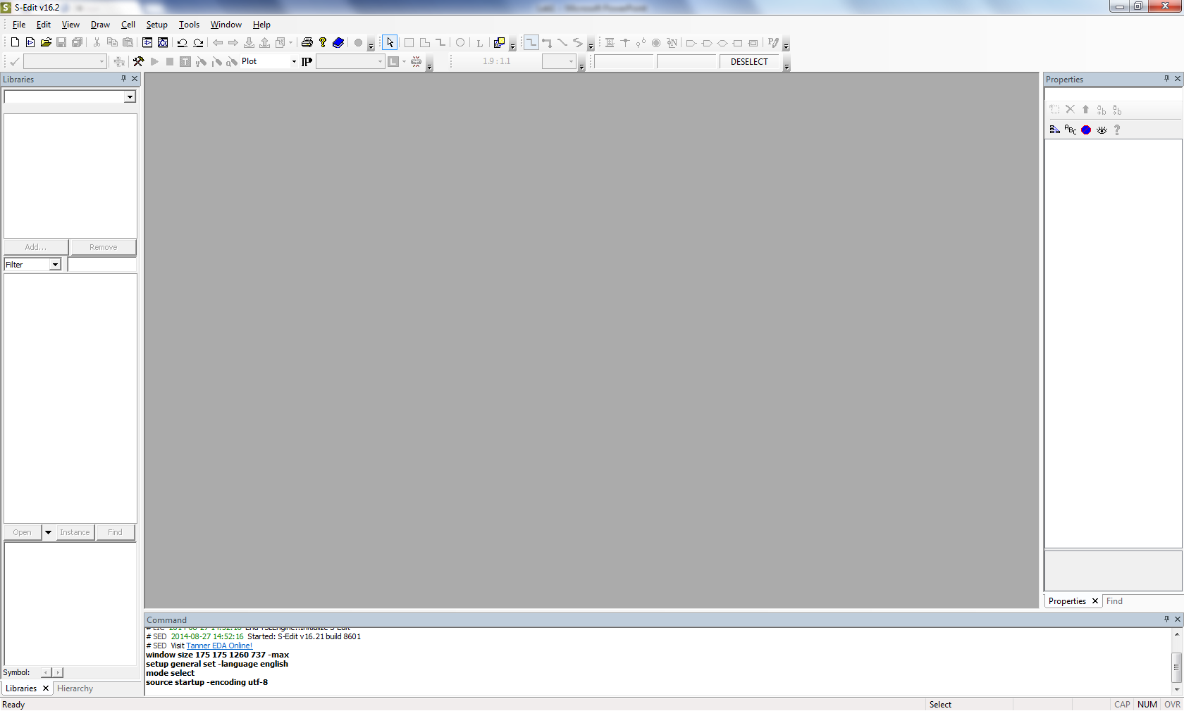
This is the startup interface

Slide 10
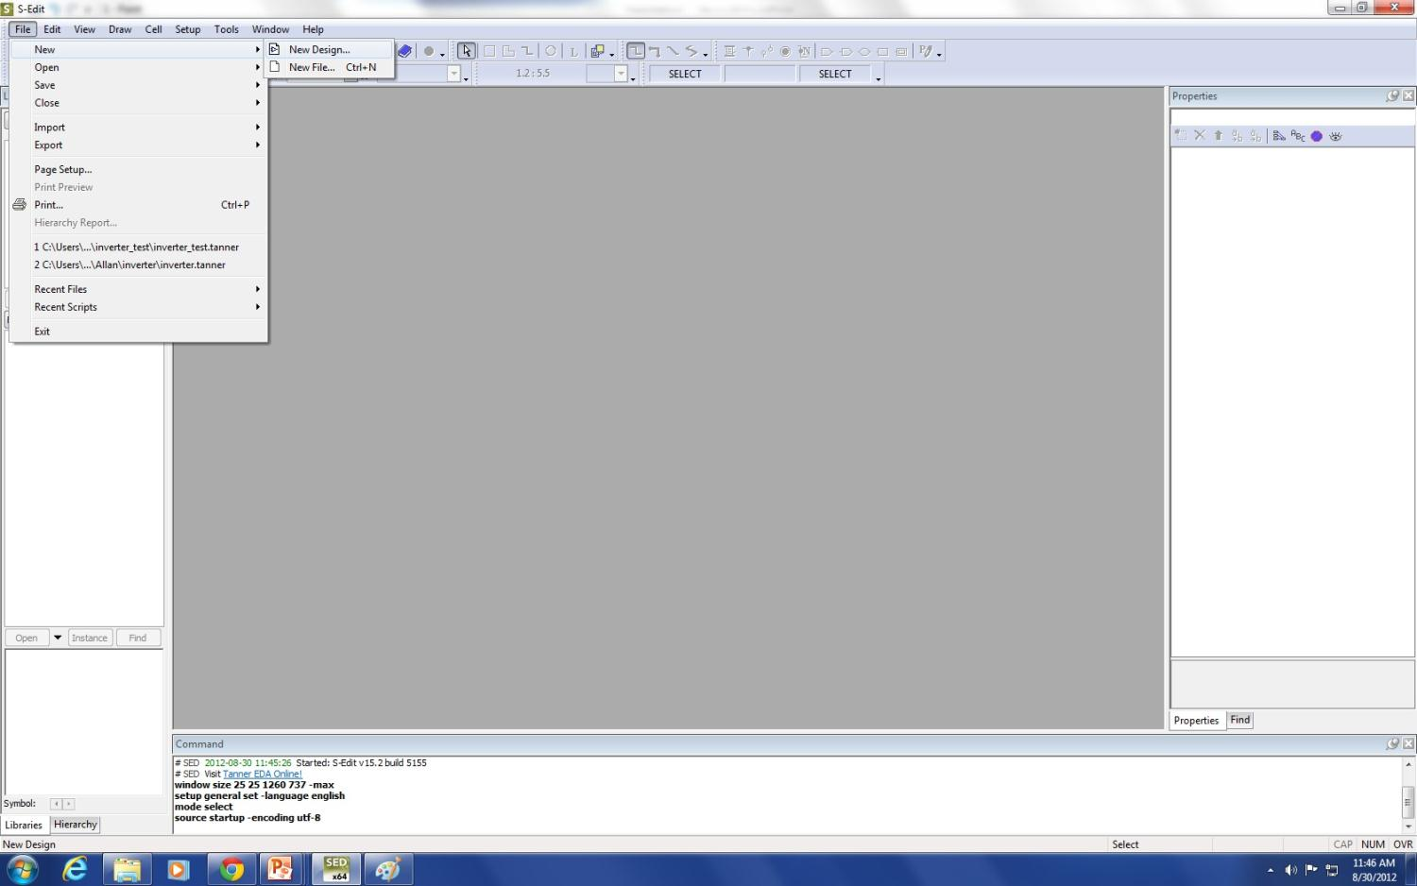
Make a new design file

Slide 11
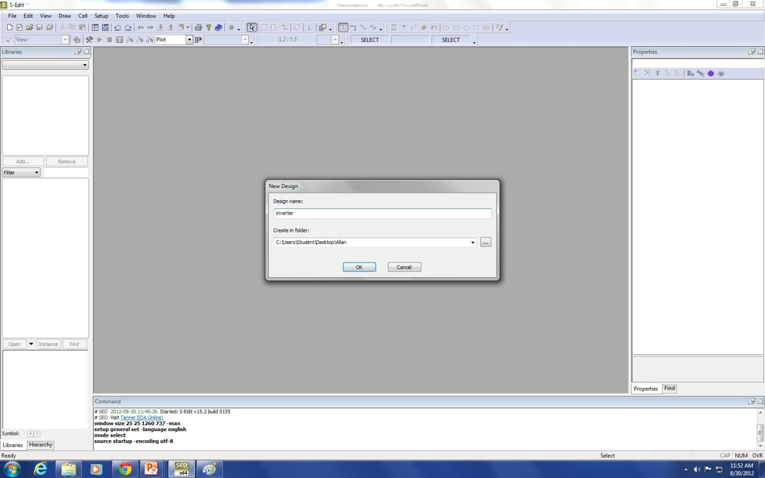
Name the design
Create a directory to store your files and set the path

Slide 12
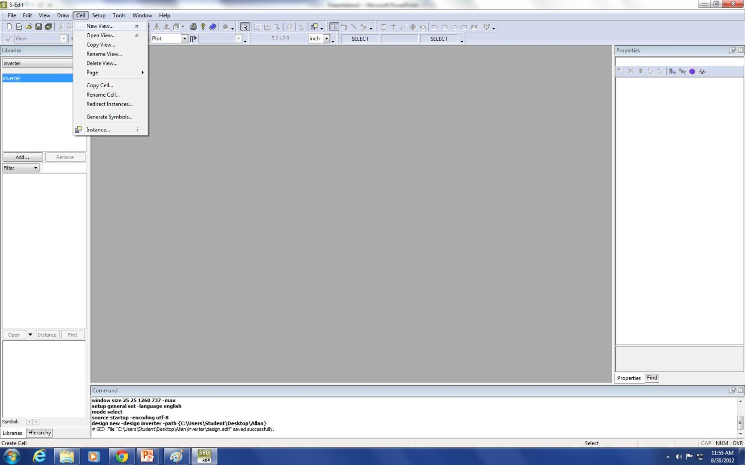
Make a new cell

Slide 13
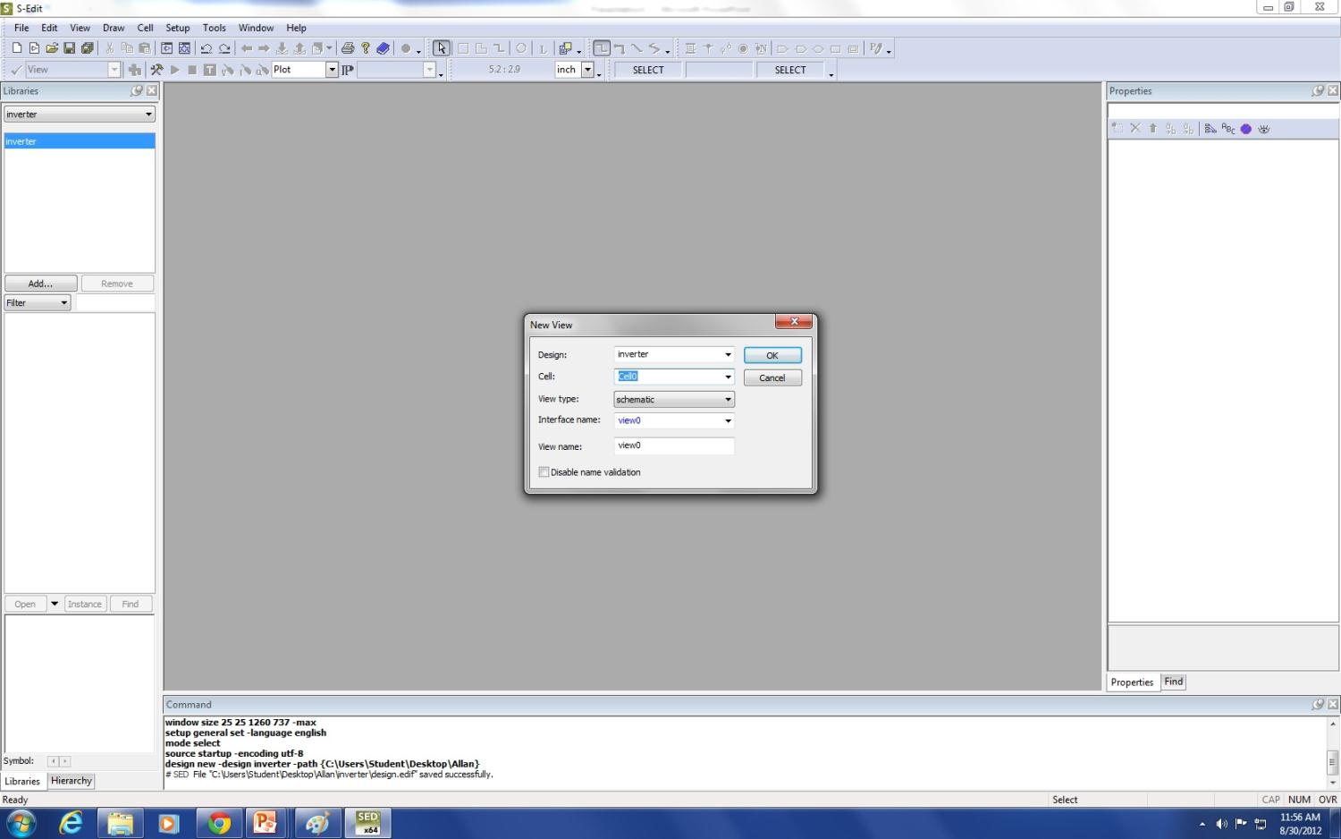
Keep the default name “cell0” and select schematic

Slide 14
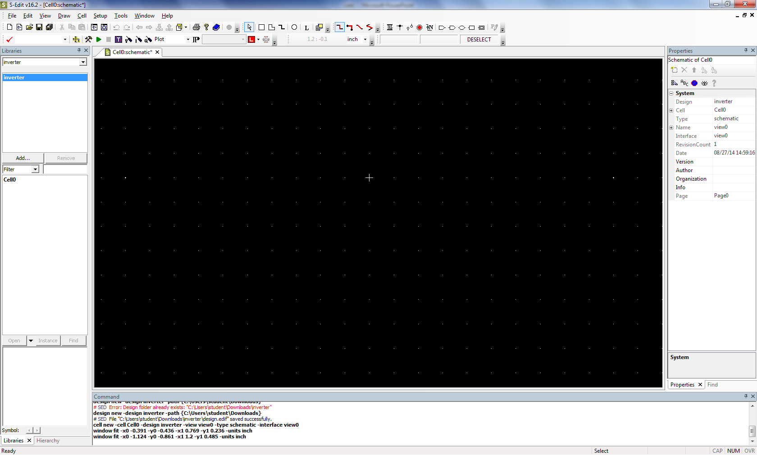
This is the schematic workspace

Slide 15
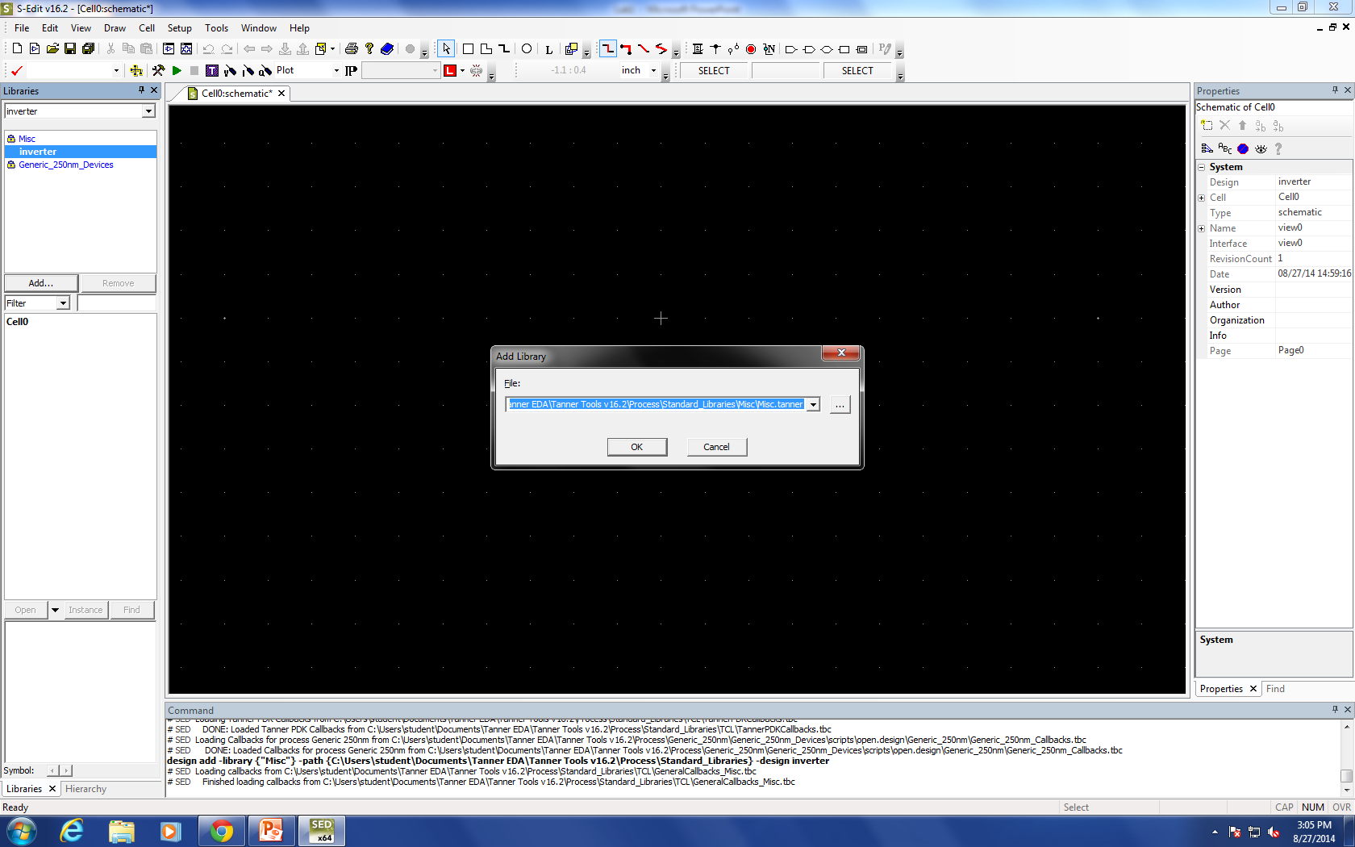
Add the following libraries:
C:\Users\Student\Documents\Tanner EDA\Tanner Tools v16.2\Process\Generic_250nm\Generic_250nm_Devices\Generic_250nm_Devices.tanner
C:\Users\Student\Documents\Tanner EDA\Tanner Tools v16.2\Process\Standard_Libraries\Misc\Misc.tanner

Slide 16
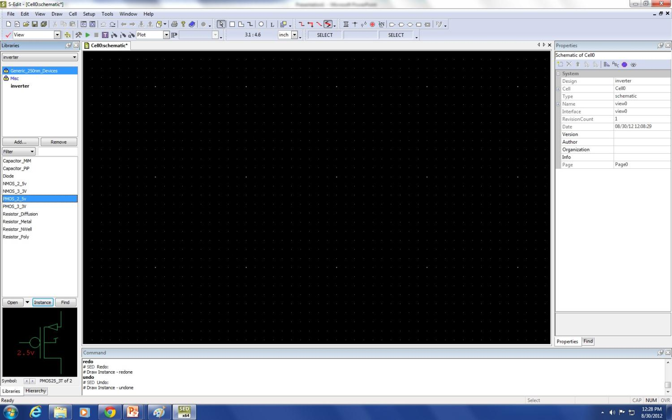
Select the Generic_250nm_Devices library
Select the desire component from the parts list
Press “Instance”

Slide 17
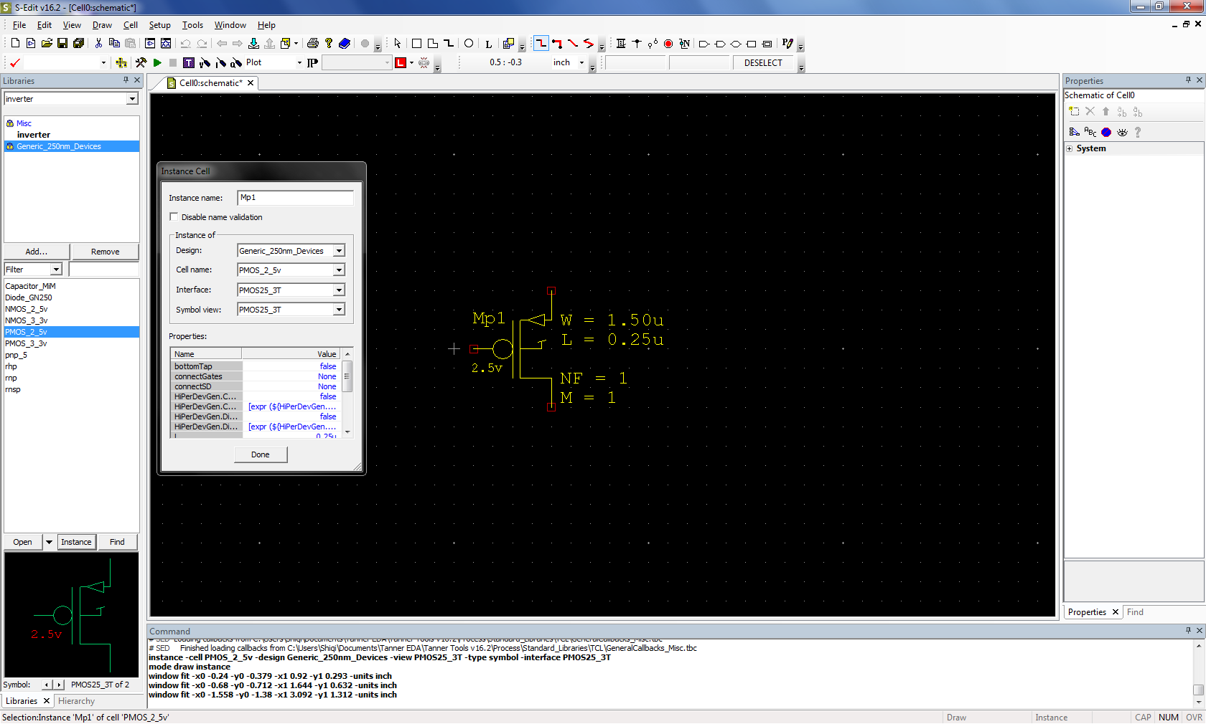
Left-click to place on grid then click Done

Slide 18
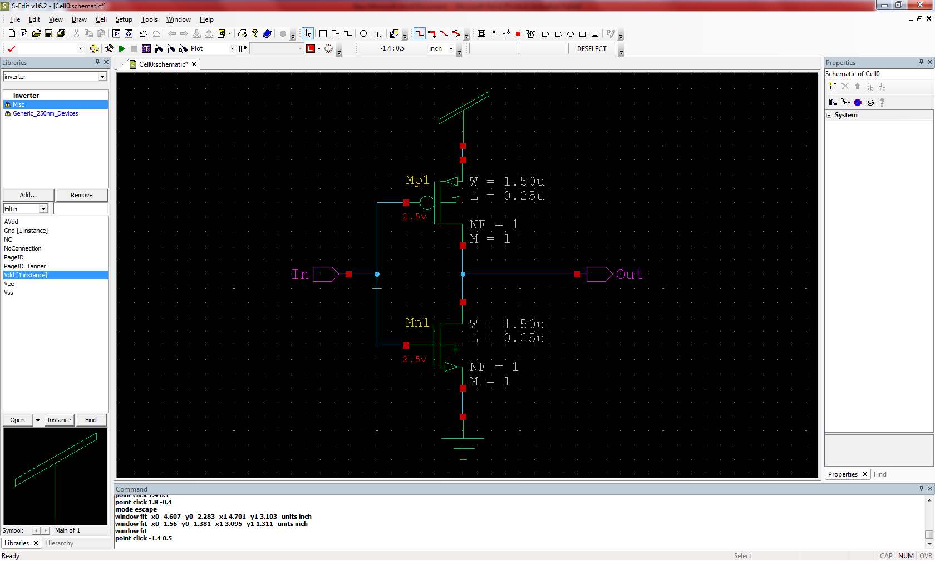
Wire
In
Out
Vdd and Gnd are found in the Misc library

Slide 19
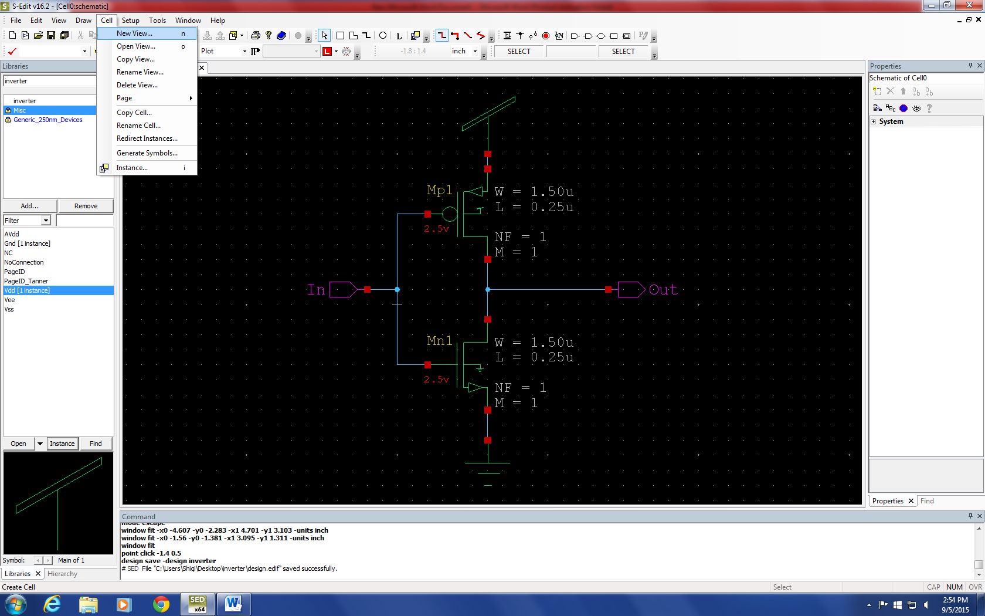
Now let’s make a symbol for the inverter

Slide 20
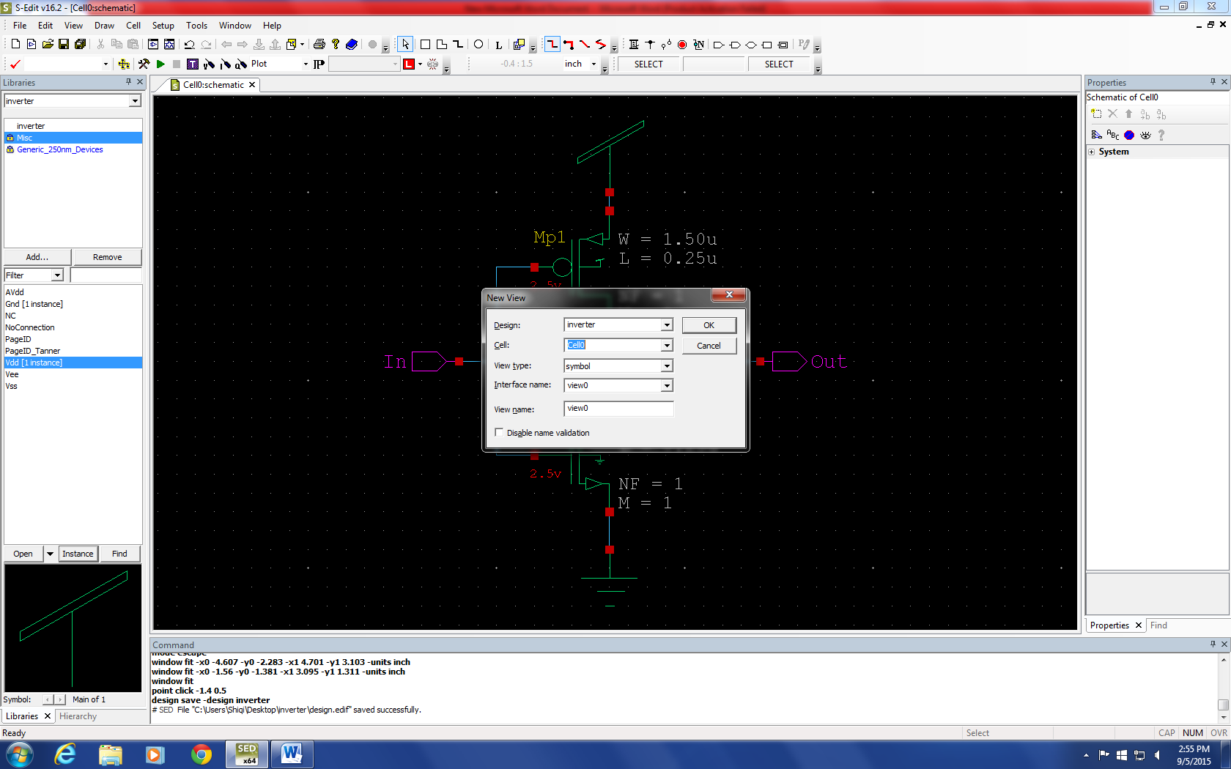
Select the same cell as your schematic. Keep “Cell0” all the time.
Select “symbol” from view
Click OK

Slide 21
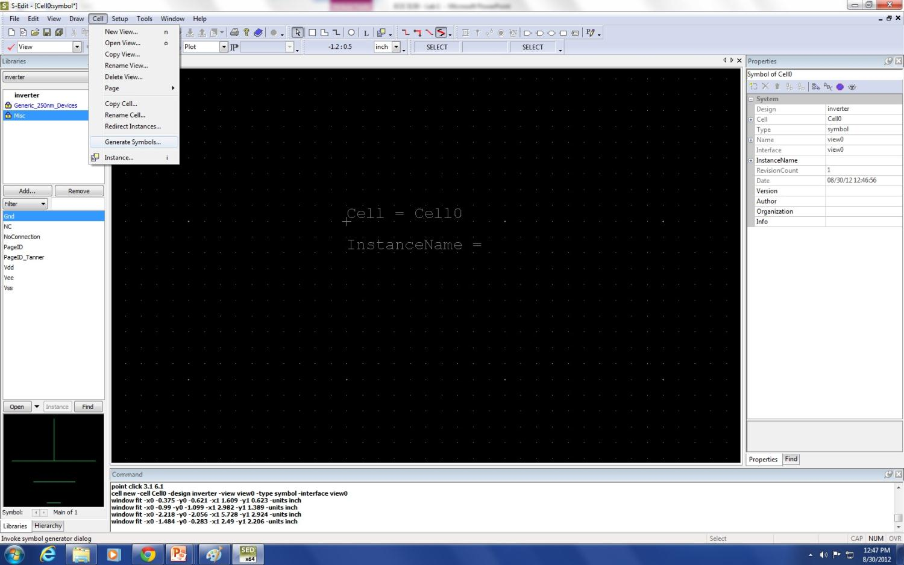
This is the symbol workspace.
Let’s have Tanner generate a symbol for us.

Slide 22
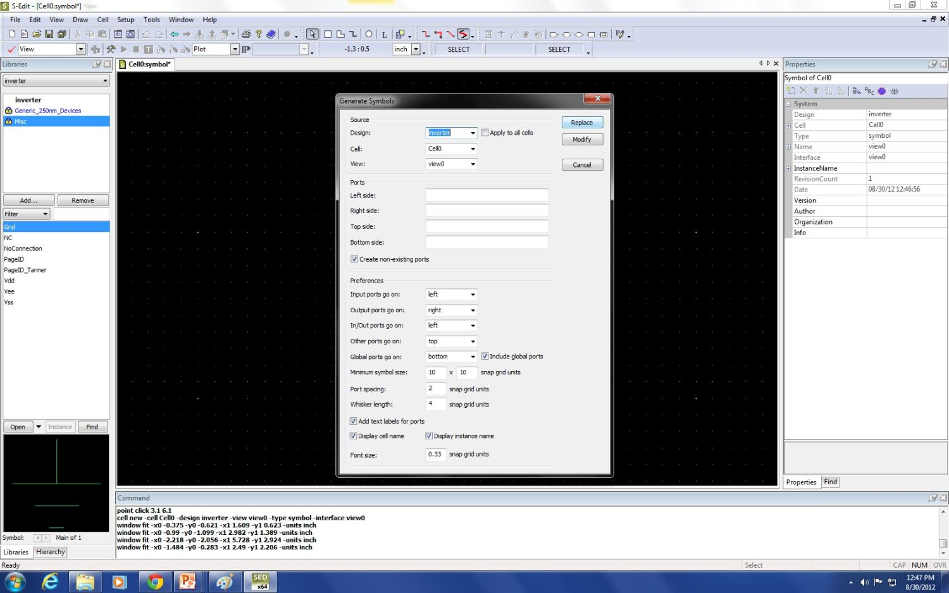
Make sure the Design and Cell are correct and then click “Replace”

Slide 23
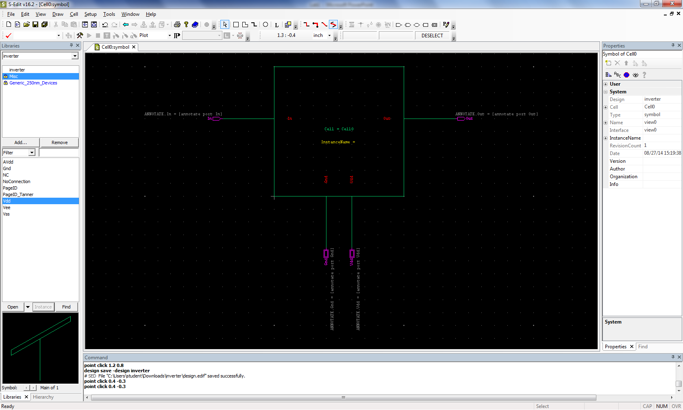
Pointer
This is the auto-generated symbol but let’s make it better.
Pick the Pointer tool, select the box, and press Backspace to delete it

Slide 24
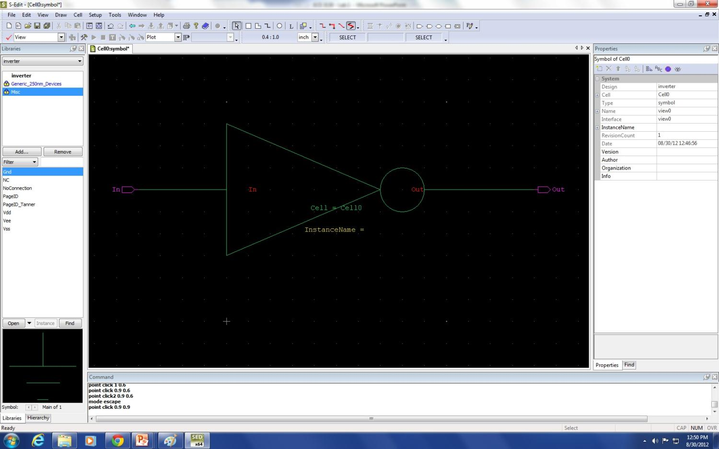
Path
All angle
Pick the “Path” tool and “All angle” selection
Draw the standard logic symbol for an inverter
Draw “paths” to connect everything

Slide 25
Building the Test Bench
Make a new design file for test bench.
Name it inverter_test
Add the inverter library, which you just built.
Add the following libraries
C:\Users\Student\Documents\Tanner EDA\Tanner Tools v16.2\Process\Standard_Libraries\SPICE_Commands\SPICE_Commands.tanner
C:\Users\Student\Documents\Tanner EDA\Tanner Tools v16.2\Process\Standard_Libraries\SPICE_Elements\SPICE_Elements.tanner

Slide 26
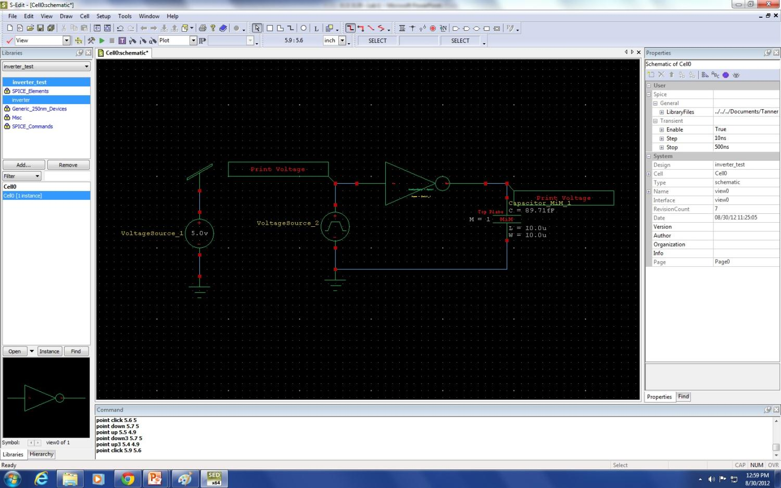
Voltage source is found in the SPICE_Elements library
Print Voltage is found in the SPICE_Commands library
Capacitor is found in the Generic_250nm_Devices library
parasitic capacitor
DC voltage
Voltage pulse

Slide 27
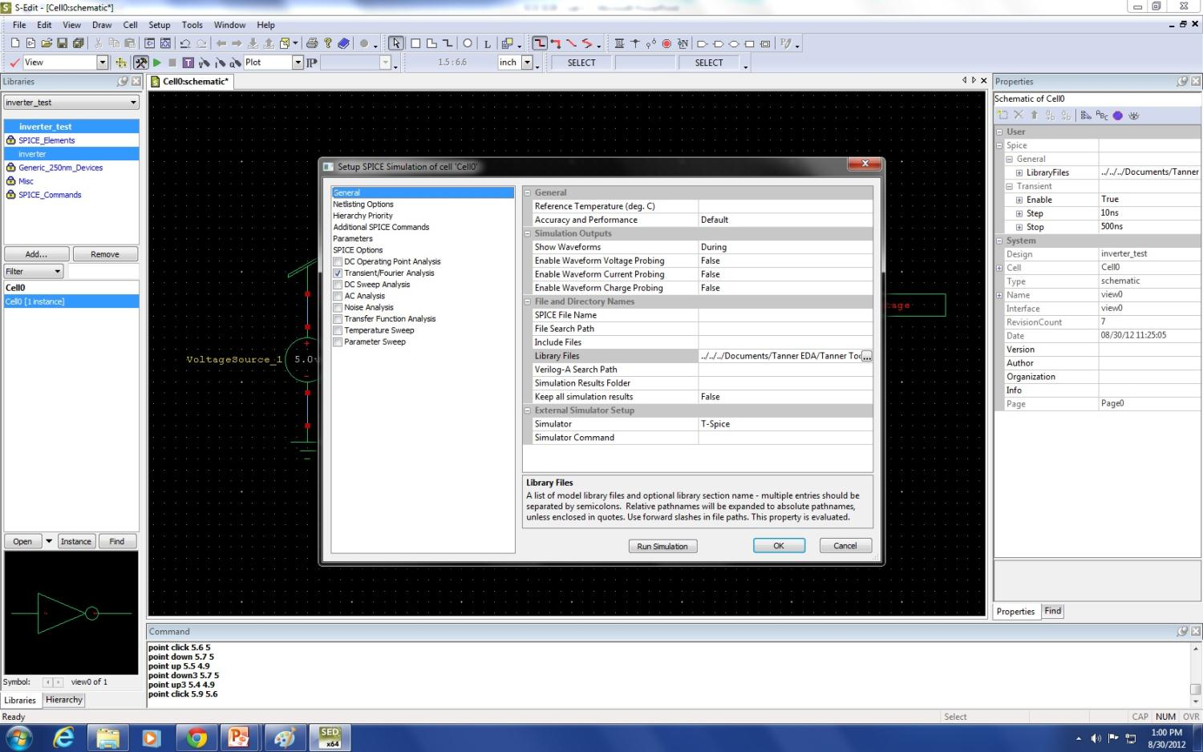
C:\Users\Student\Documents\Tanner EDA\Tanner Tools v16.2\Process\Generic_250nm\Generic_250nm_Tech\Generic_250nm.lib TT
Press this button to set up the simulation
Type TT after entering C:\Users\Student\Documents\Tanner EDA\Tanner Tools v16.2\Process\Generic_250nm\Generic_250nm_Tech\Generic_250nm.lib

Slide 28
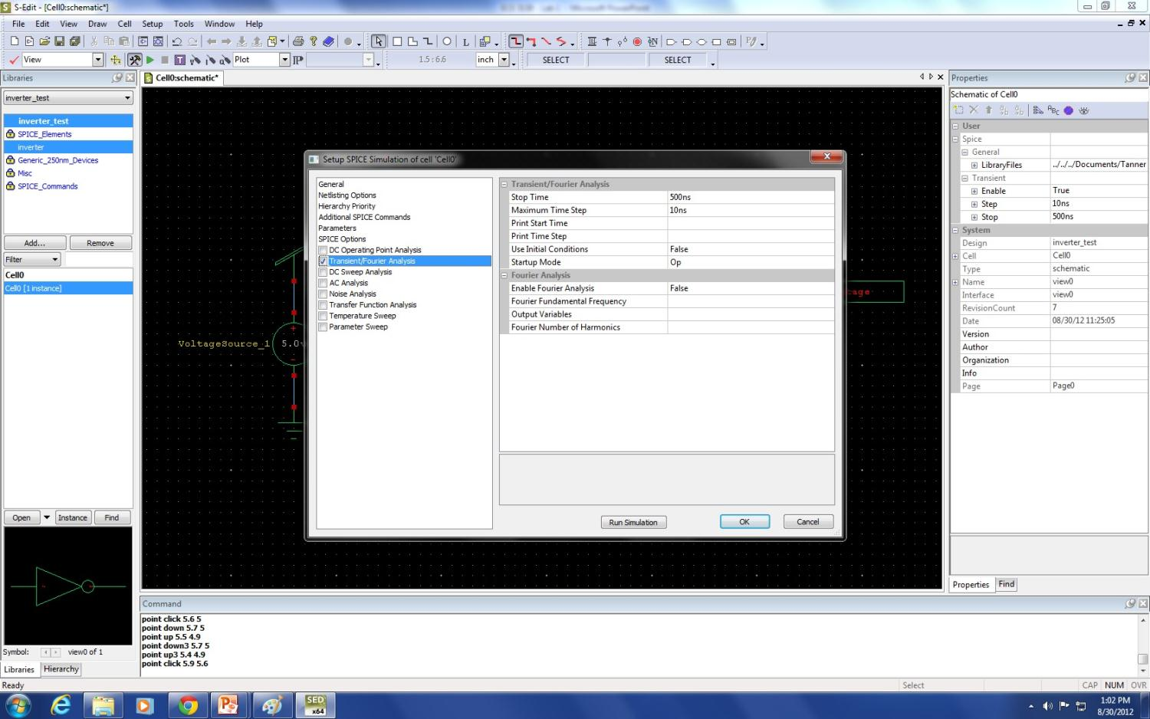
Set the stop time and maximum time step and click Run Simulation

Slide 29
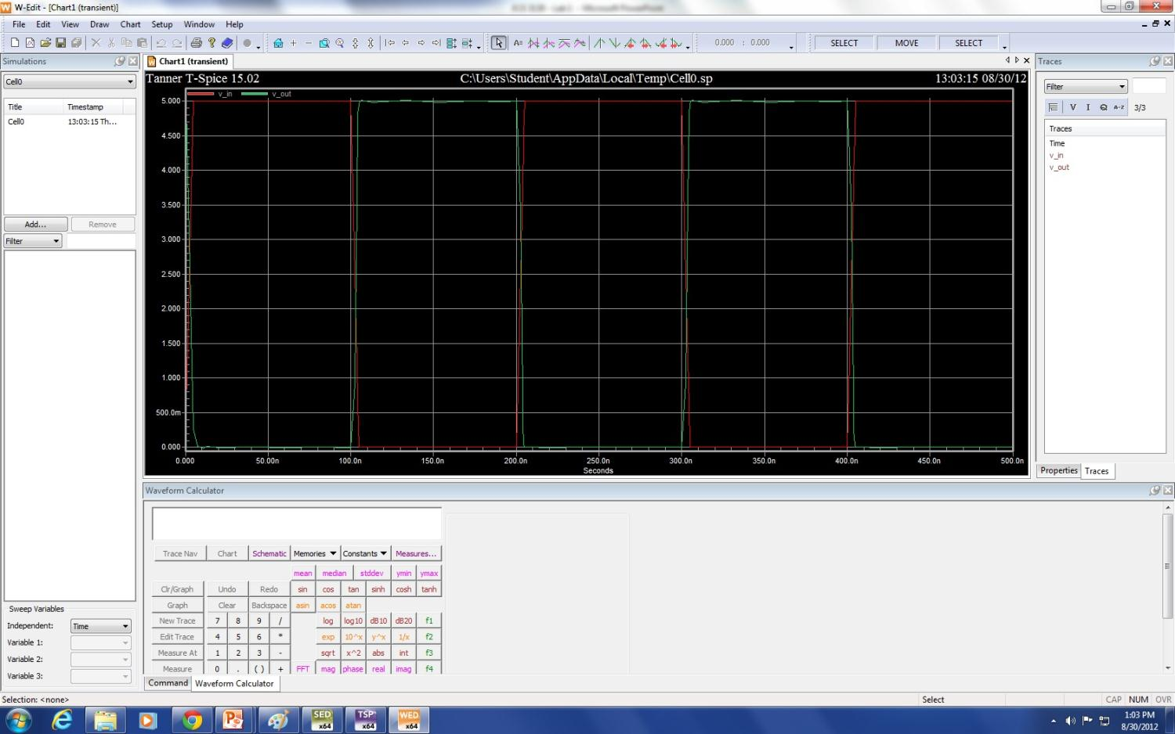

Slide 30
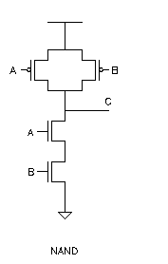
NAND Gate
Truth table
Implementation
A | B | Output
0 | 0 | 1
0 | 1 | 1
1 | 0 | 1
1 | 1 | 0

Slide 31
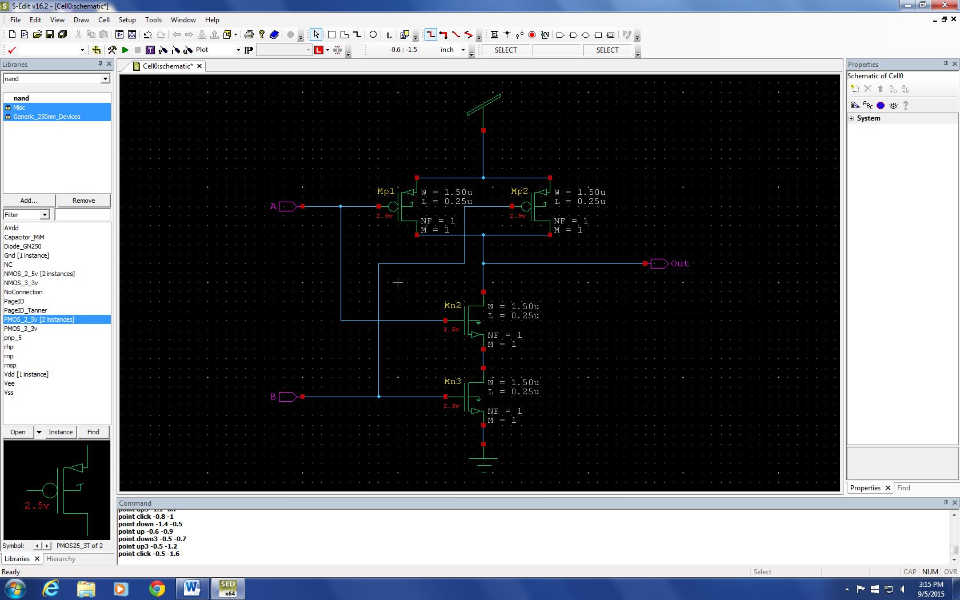
Schematic – NAND gate

Slide 32
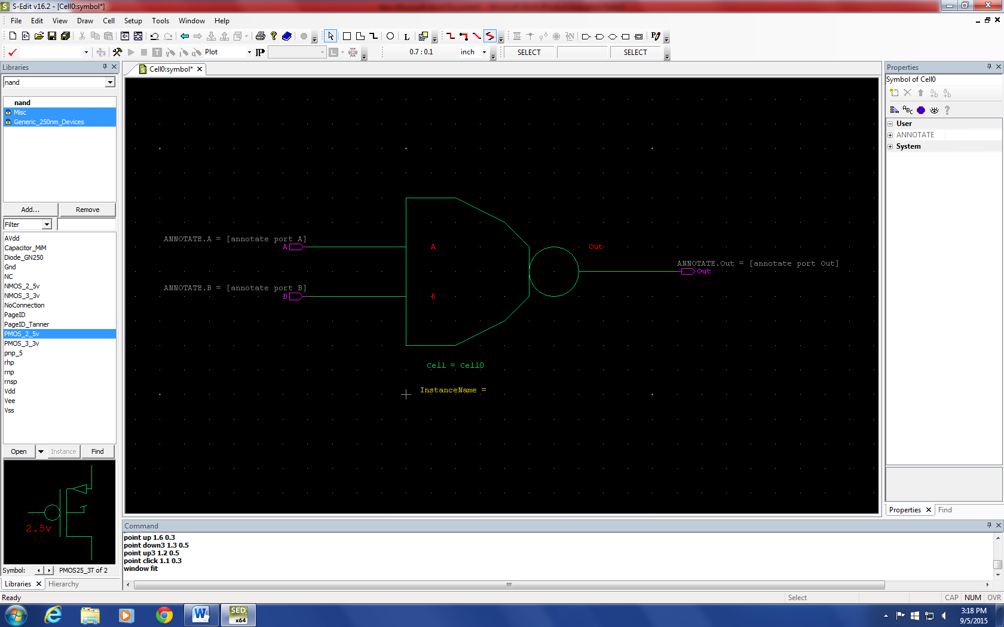
Symbol – NAND gate

Slide 33
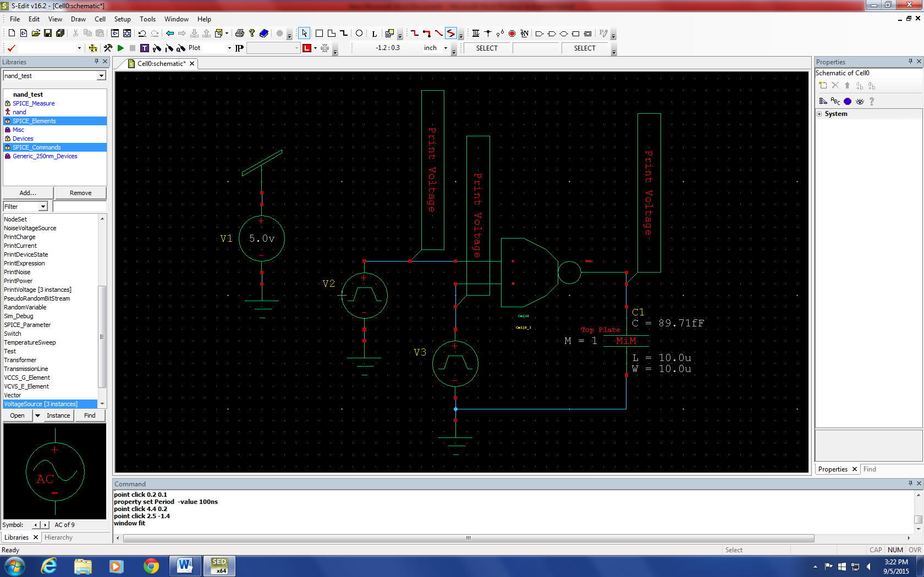
Test bench Circuit – NAND gate

Slide 34
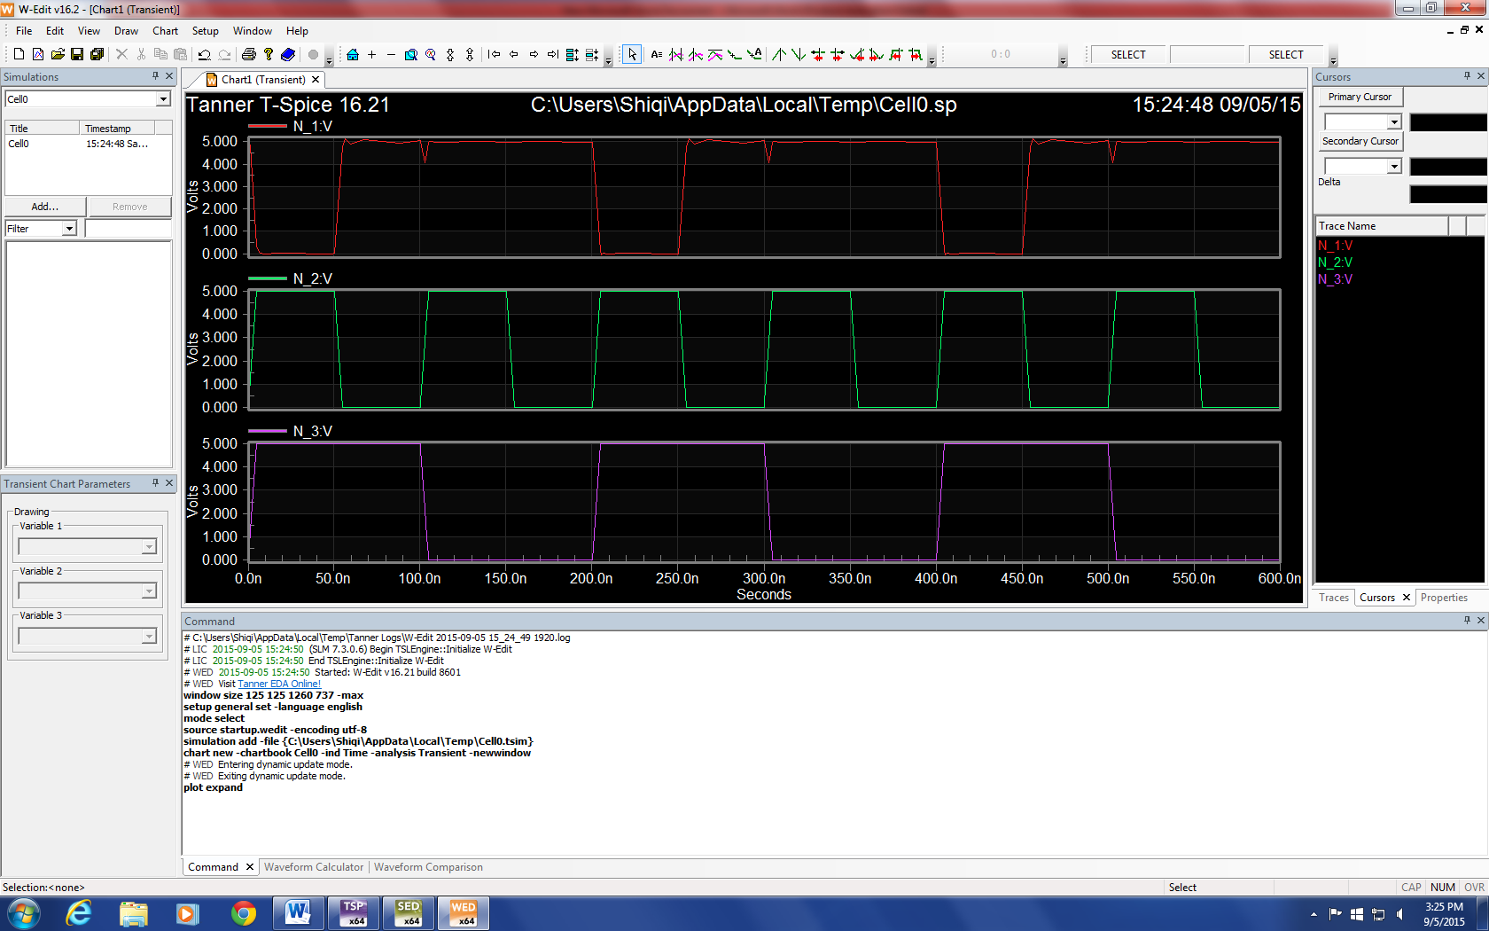
Simulation results – NAND gate

Slide 35
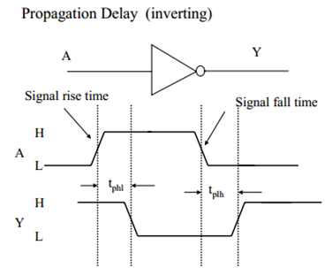
Propagation Delay (t_{P})
When the gate inputs change, the outputs do not change instantaneously
Defined as the latency between a change in the input and a change in the output measured from the 50% point at the input and the 50% point at the output
t_{PHL} – the time it takes for the output to switch from HIGH to LOW
t_{PLH} – the time it takes for the output to switch from LOW to HIGH

Slide 36
Analysis
Tabulate the propagation delays (t_{PHL}, t_{PLH}) for the inverter and NAND gate.
Record the waveforms.

Slide 37
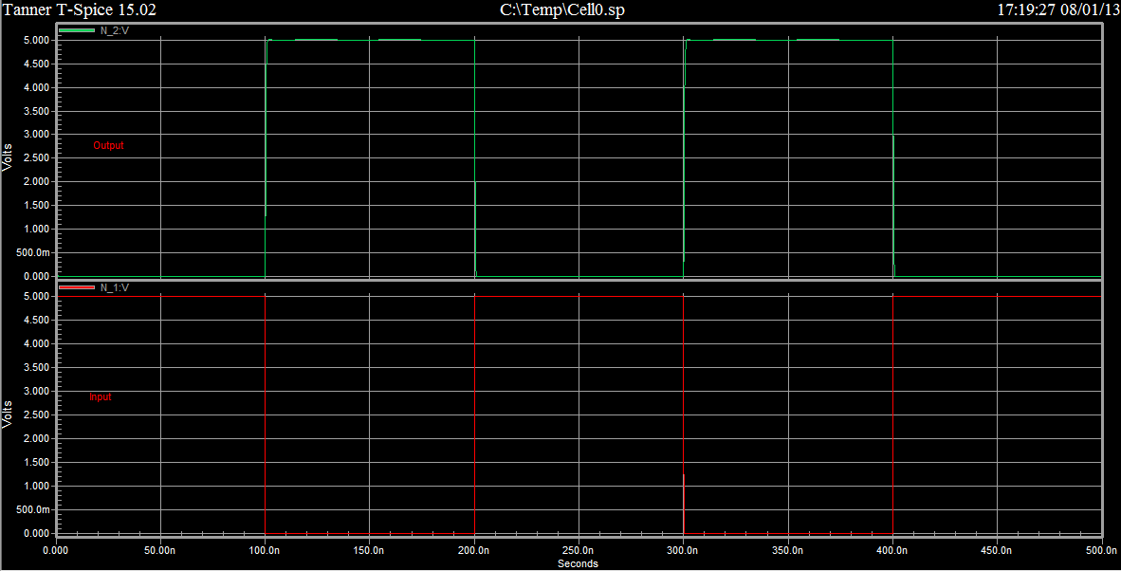
Waveform - Inverter

Slide 38
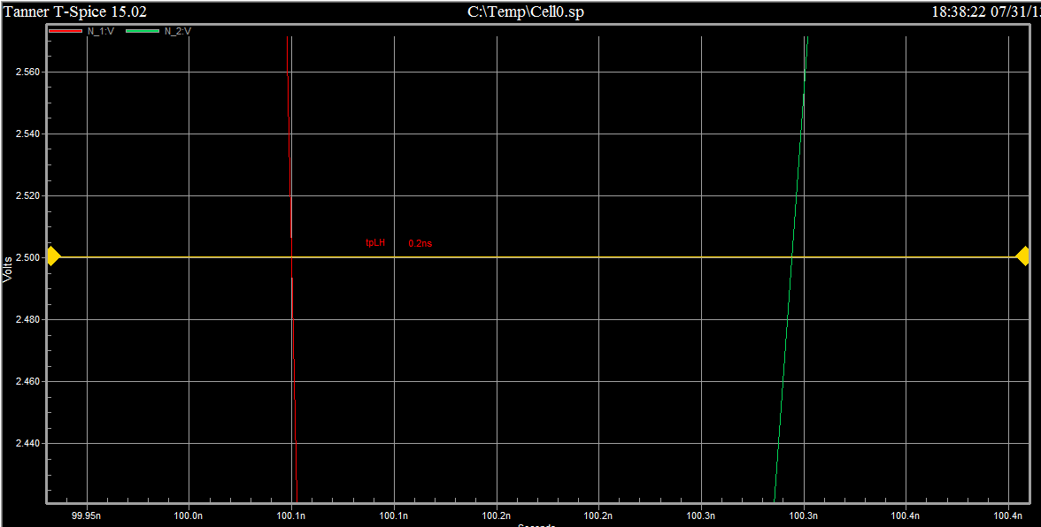
Propagation Delay – Inverter(t_{PLH})
t_{PLH} = 0.2ns

Slide 39
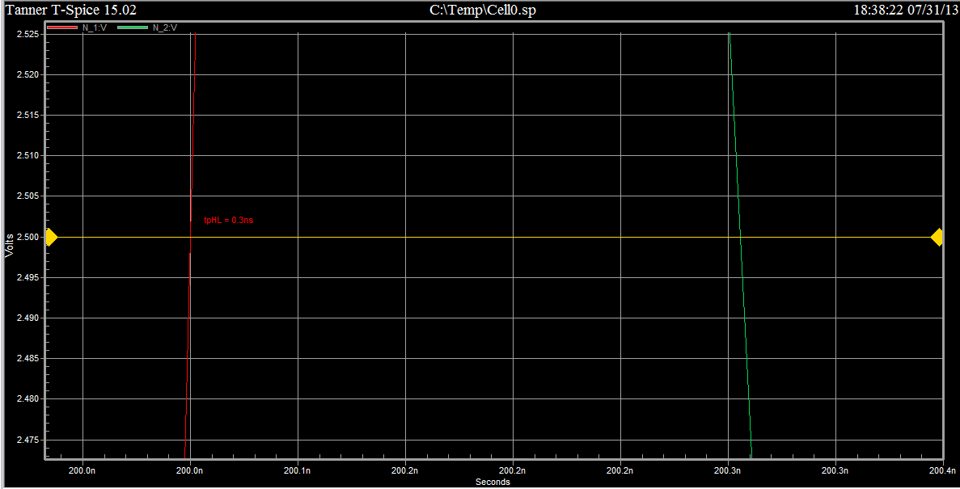
Propagation Delay – Inverter(t_{PHL})
t_{PHL} = 0.3ns

Slide 40
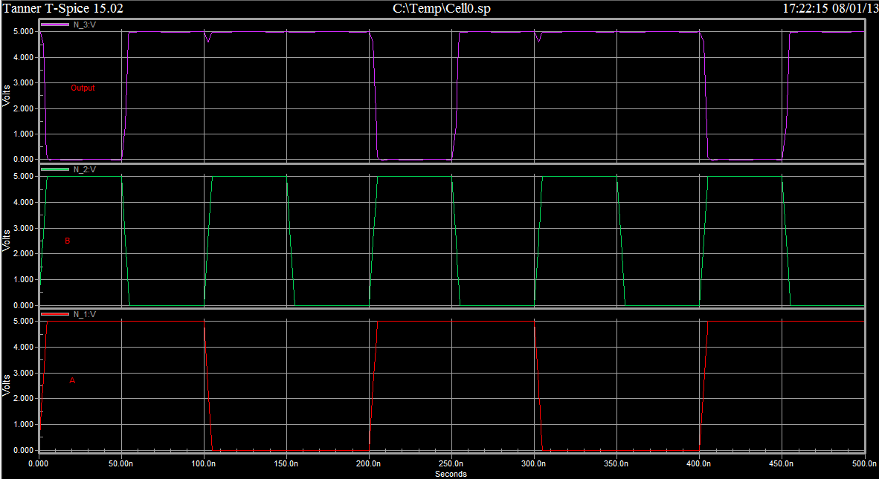
Waveform - NAND

Slide 41
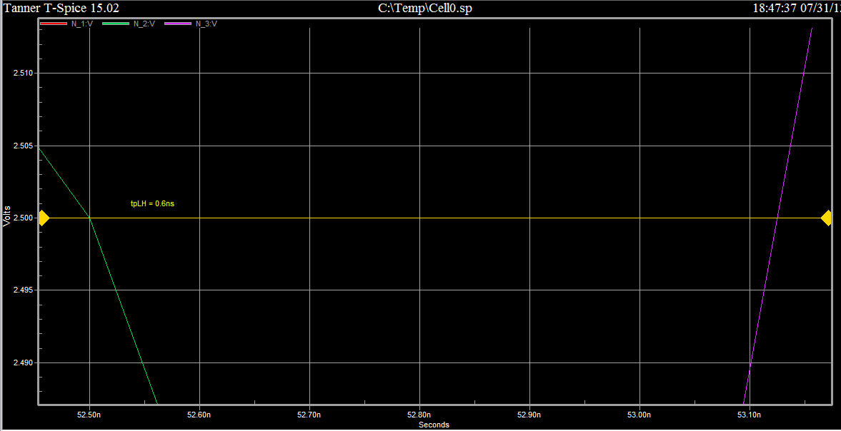
Propagation Delay – NAND (t_{PLH})
t_{PLH} = 0.6ns

Slide 42
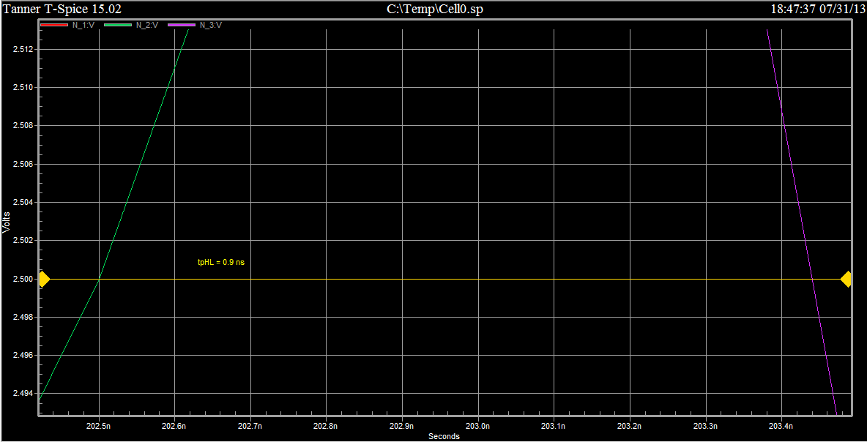
Propagation Delay – NAND (t_{PHL})
t_{PHL} = 0.9ns

